Slide 1


From Prototype to Product: Technological Foundations for Vibe-Coders
A comprehensive guide to understanding what happens behind the scenes when building real applications with vibe-coding tools.

Slide 2
Session Goals
Bridge the gap
Learn the transition from prototyping with LLMs to full deployment using tools like Base44, Lovable, and Bolt
Build foundational knowledge
Understand backend systems, databases, and APIs without needing technical expertise
Develop responsible practices
Learn what you need to know to build effectively with Vibe-Coding platforms
By the end of this session, you'll understand how apps run on the internet, where data is stored, and how APIs extend your app's capabilities.

Slide 3
Agenda
Quick recap - What is Prototyping?
Why Prototyping Isn't Enough
Basic Developing Foundational Concepts
  How a Website Really Works: Frontend, Backend, Hosting, Client-Server Communication
  From App to Data – How Databases Work
  You Don’t Have to Build It All – Meet APIs

Slide 4
Quick recap - What is Prototyping?
Prototyping is the process of quickly creating a simplified version of a product to test ideas, features, or workflows before full development.
Purpose of Prototyping:
Explore and validate ideas with real users
Get early feedback without full commitment
Iterate rapidly on design, logic, or interface
Communicate concepts to stakeholders or investors
Why it matters:
Vibe-Coding platforms are costly and depend heavily on user interaction, prompt design, and feedback cycles. A prototype helps test which prompts work best before building the full app, and help you create the best application within the platform costly limitations.

Slide 5
Quick recap - What is Prototyping?
Prototyping Enables:
Prompt Design - Explore different prompts for your desired output
Testing - No-code tools help test and refine prompt chains, UI input types, and output formatting
Side-by-Side Comparison - Compare different prompt approaches and product ideas and see results immediately
Rapid Feedback Loop - Get feedback and make changes without backend changes

Slide 6
Why Prototyping Isn't Enough
Prototyping = idea exploration, not real product
Limitations of AI-based prototypes (with ChatGPT, Claude, Gemini):
Data isn't saved between sessions
Logic doesn't run in real time and on the user's browser
Not connected to internet services
You need deployment when:
Real users will submit data and logs of your app will be saved somewere
You want to launch a working tool that all of it functions acctually work (and not just 'seem' working)

Slide 7
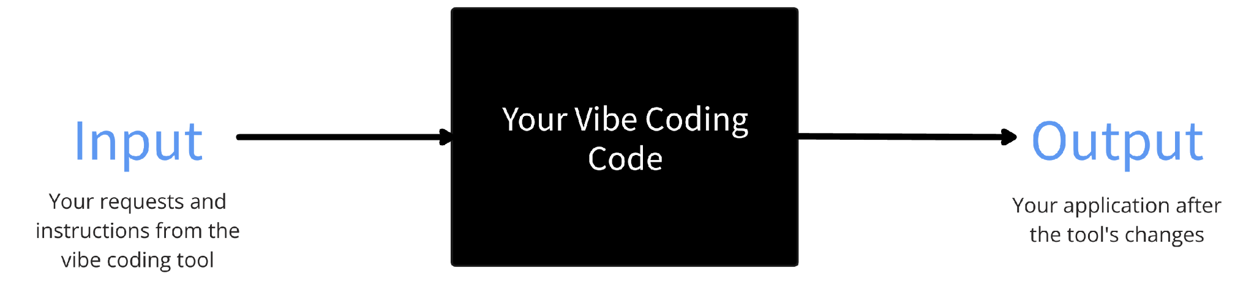
Why as a "Vibe Coder" you should know technological basics?
In vibe coding you understand you app by inserting an input and looking on the output ("the black box")
Learning basic developing concepts will help you to get more comfortable with it and to become a smart and secure vibe-coder..!

Slide 8
Basic Developing Foundational Concepts

Slide 9
How a Website Works // Full Stack Development

Slide 10
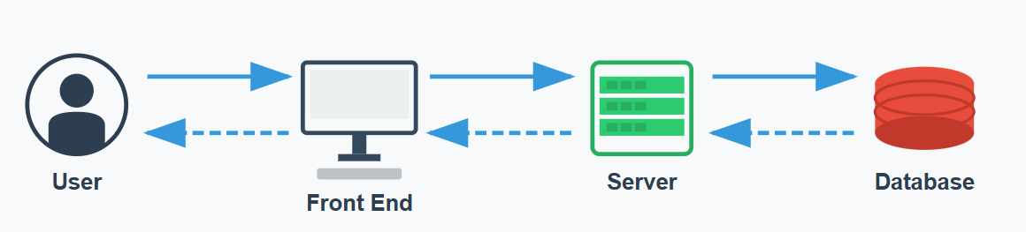
How a Website Really Works
User: The person using your app (like visitors to your website).
Front End: What users see and interact with (the website interface - buttons, texts, etc.)
Server: The brain that processes requests and handles the app logic. Also called Backend
Database: Where all your app's information is stored (user data, content, etc.)
Client-Server Communication - How the frontend and backend talk to each other
Hosting - Where your app lives online so people can access it

Slide 11
How a Website Really Works
Full Stack Development!
Vibe-Coding platforms handle these technical components, letting you focus on building your app while focusing on your product, without all of this technical headache..!

Slide 12



The Frontend – What the User Sees
Frontend = Everything that the user sees and engage with; Everything that shows up in the browser. Created using HTML, CSS, and JavaScript
User Experience (UX)
User interface (UI)
How the app feels: intuitive, smooth, and pleasant to use
The actual design elements the user interacts with: buttons, forms, images, icons
Consider: Is it clear what to click? Is the flow logical?
UX focuses on the user journey and satisfaction from start to finish
A well-designed UI makes the app easy to navigate and visually appealing
UX ←→ UI
UI impacts UX: a beautiful but confusing UI ruins the experience
UX influences UI: understanding user needs shapes the interface design
Together they define how usable and enjoyable your app is
In vibe coding platforms, you define the front using your prompts!

Slide 13
The Frontend – What the User Sees
The prototyping we made with Claude/Gemini/ChatGPT
is the Frontend!
In order to develop a full working product, you need also backend..! → A fullstack app!

Slide 14




The Server / Backend – What Happens Behind the Scenes
Backend = Logic and processing engine. Behind the scenes of the app. When a user interacts with the app, backend decides what happens:
User Action
Backend Processing
Data Storage
Response
A visitor completes a form or clicks a button on your website
Logic determines what to do with the request
Information is saved or retrieved as needed
The user sees the result of their action
Store information?
Send confirmation?
Show different page?
Analogy: Backend is the kitchen, Frontend is the diner, API is the menu
Customers sees and engage only with the menu and don't see the kitchen, but the kitchen is where all the important work happens.

Slide 15

Hosting – Where Your App Lives
Hosting = where your app “sits” so people can access it online. The physical or virtual space where your app files are stored so people can access them online.
Analogy: The building where your app files are being stored
How it works with vibe-coding tools:
Base44, Lovable and other platforms handle hosting automatically
You simply press "Deploy" or "Publish" and your app gets its own web address (URL)
Users can access your web app from anywhere

Slide 16




Client-Server Communication
Client-Server Communication = How data moves between frontend and backend
When you click a button on a website:
Client Request
Server Processing
Server Response
Client Update
Your browser (the client) sends a message to the server when you interact with the website (i.e. click on a button)
The server receives the request, processes it using the backend logic
The server sends back a reply (i.e. data, updated content, confirmation)
Your browser displays the new information or confirms the action
Vibe-Coding platforms automate this process without requiring you to write code, only to request. However! it's important to make sure that all the logic flow in your app is performed correctly..!

Slide 17

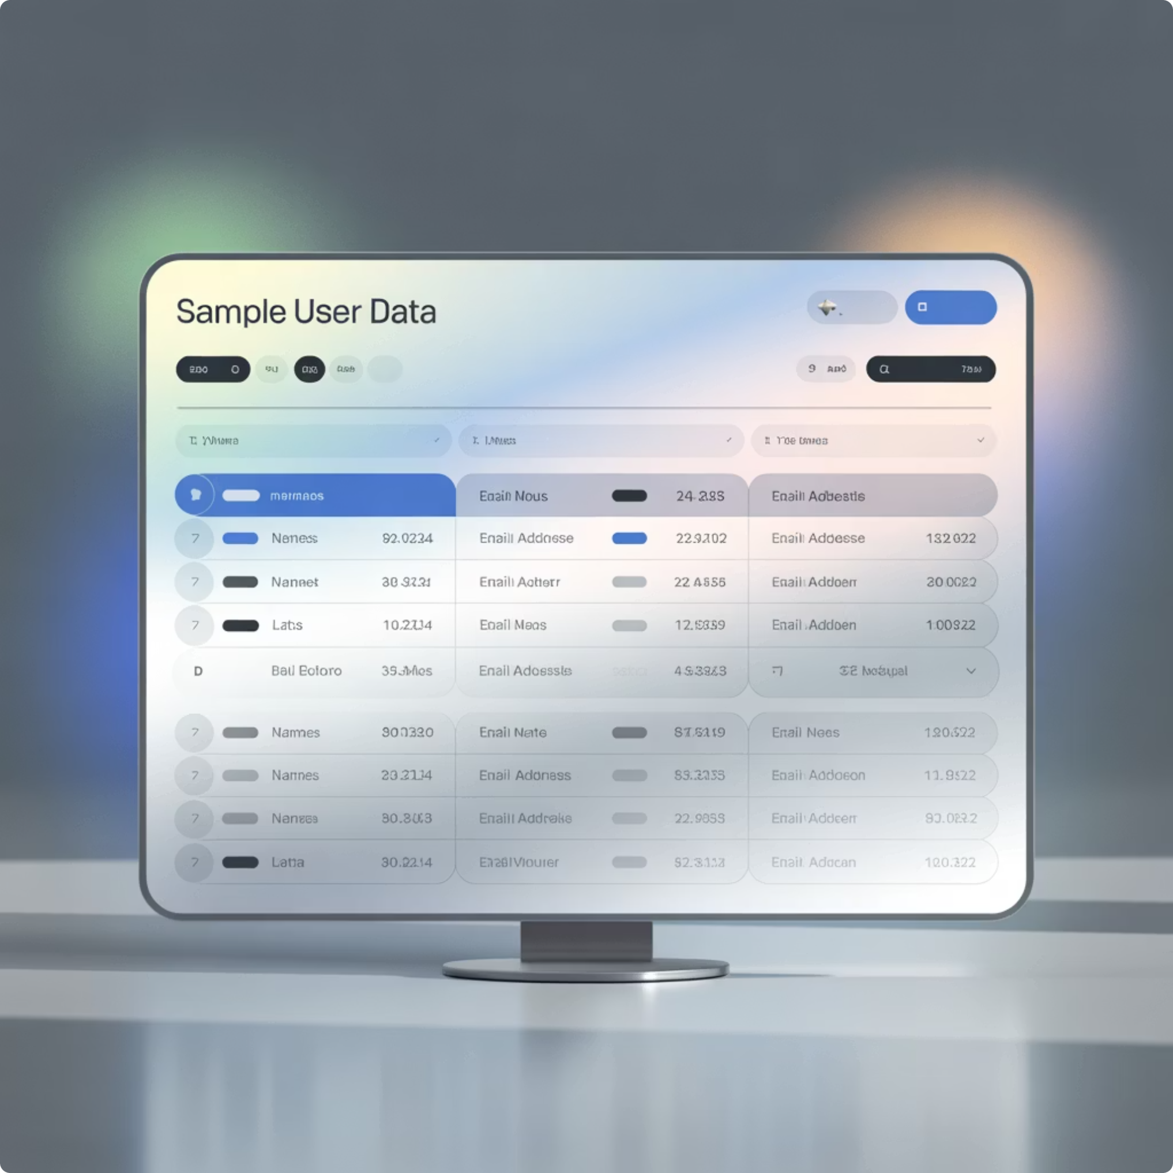
DataBase – How Databases Work
A database is where your app stores all information (i.e. users, tasks, answers).
What is Database (DB)?
Think of it as a spreadsheet / excel file:
Tables: Different lists of information (Users, Products, Orders)
Rows: Individual entries (a specific user, product, or order)
Columns: Fields that describe each entry (name, email, date)
Example: A user submits a contact form → data saved to “Leads” table
In vibe coding platforms:
You define what data you want to collect
The platform automatically builds (or instruct you in a simple way) and connects the database of your app
Importantly! You should make sure that the data is structured how you want..!

Slide 18
2. API

Slide 19



You Don’t Have to Build It All – Meet APIs
API = Application Programming Interface. The technology via apps talk to the world.
In developing, you don’t need to build every function from scratch! People and companies already wrote many things, and you can use their code parts using APIs.
Analogy: APIs are Lego blocks you can connect to your app. They let you add powerful features without building everything from scratch.
API Examples:
Payment Processing
AI Capabilities
Calendar Integration
Connect to Stripe API to accept secured credit card payments without handling sensitive card data yourself
Use OpenAI's API to generate text, analyze content, or create images within your application with ChatGPT
Connect to Google Calendar API to schedule meetings or display upcoming events in your app page

Slide 20
API Flow
Example: You created a technical assistant application which instruct users how to solve their technical problems in a natural and easy language. The user asks a question:
1
2
3
4
5
Client Request
Server Processing
API Call
Server Response
Client Update
Your browser (the client) sends a message to the server when the user clicked on the 'send' button
The server receives the request, processes it using the backend logic. In this logic, there is an API call
Your server make an API call using your unique Open AI's API key, and gets back the services of ChatGPT LLM, which generate a response to the user question
The server gets the reply from the API, and sends back a reply to the user
The user's browser displays the answer in the chat

Slide 21
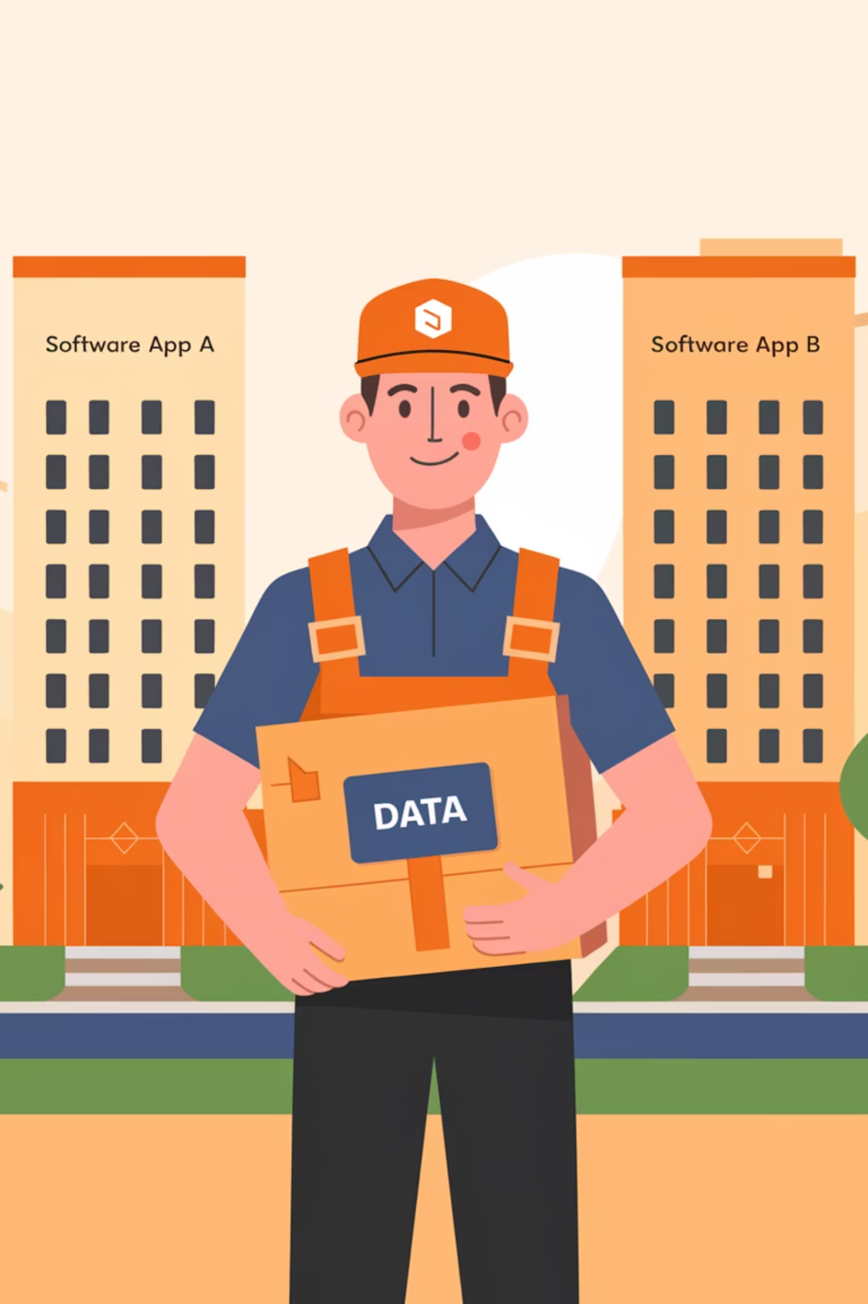



API Flow
API is like a the delivery man:
He gets a delivery request from your app (Software A)
Goes to where the delivery is taken from (Software B)
Gets it back to Software A

Slide 22
API Keys, Pricing, and Things to Know
API key
Free vs. Paid APIs:
In vibe coding tools:
To use most APIs, you need an API key: A secret password that connects your app to the API
Many services offer free tiers (limited number of requests)
You’ll be asked to paste the API key in a secure settings area
Exceeding limits costs money – plan your usage accordingly
You might define limits or use environment variables for safety
You get it by signing up to the service (Stripe, OpenAI, etc.)
Always read the pricing page of the API provider
Never share your API key publicly! – it gives access to your account
Experiment with a free tier APIs first!

Slide 23

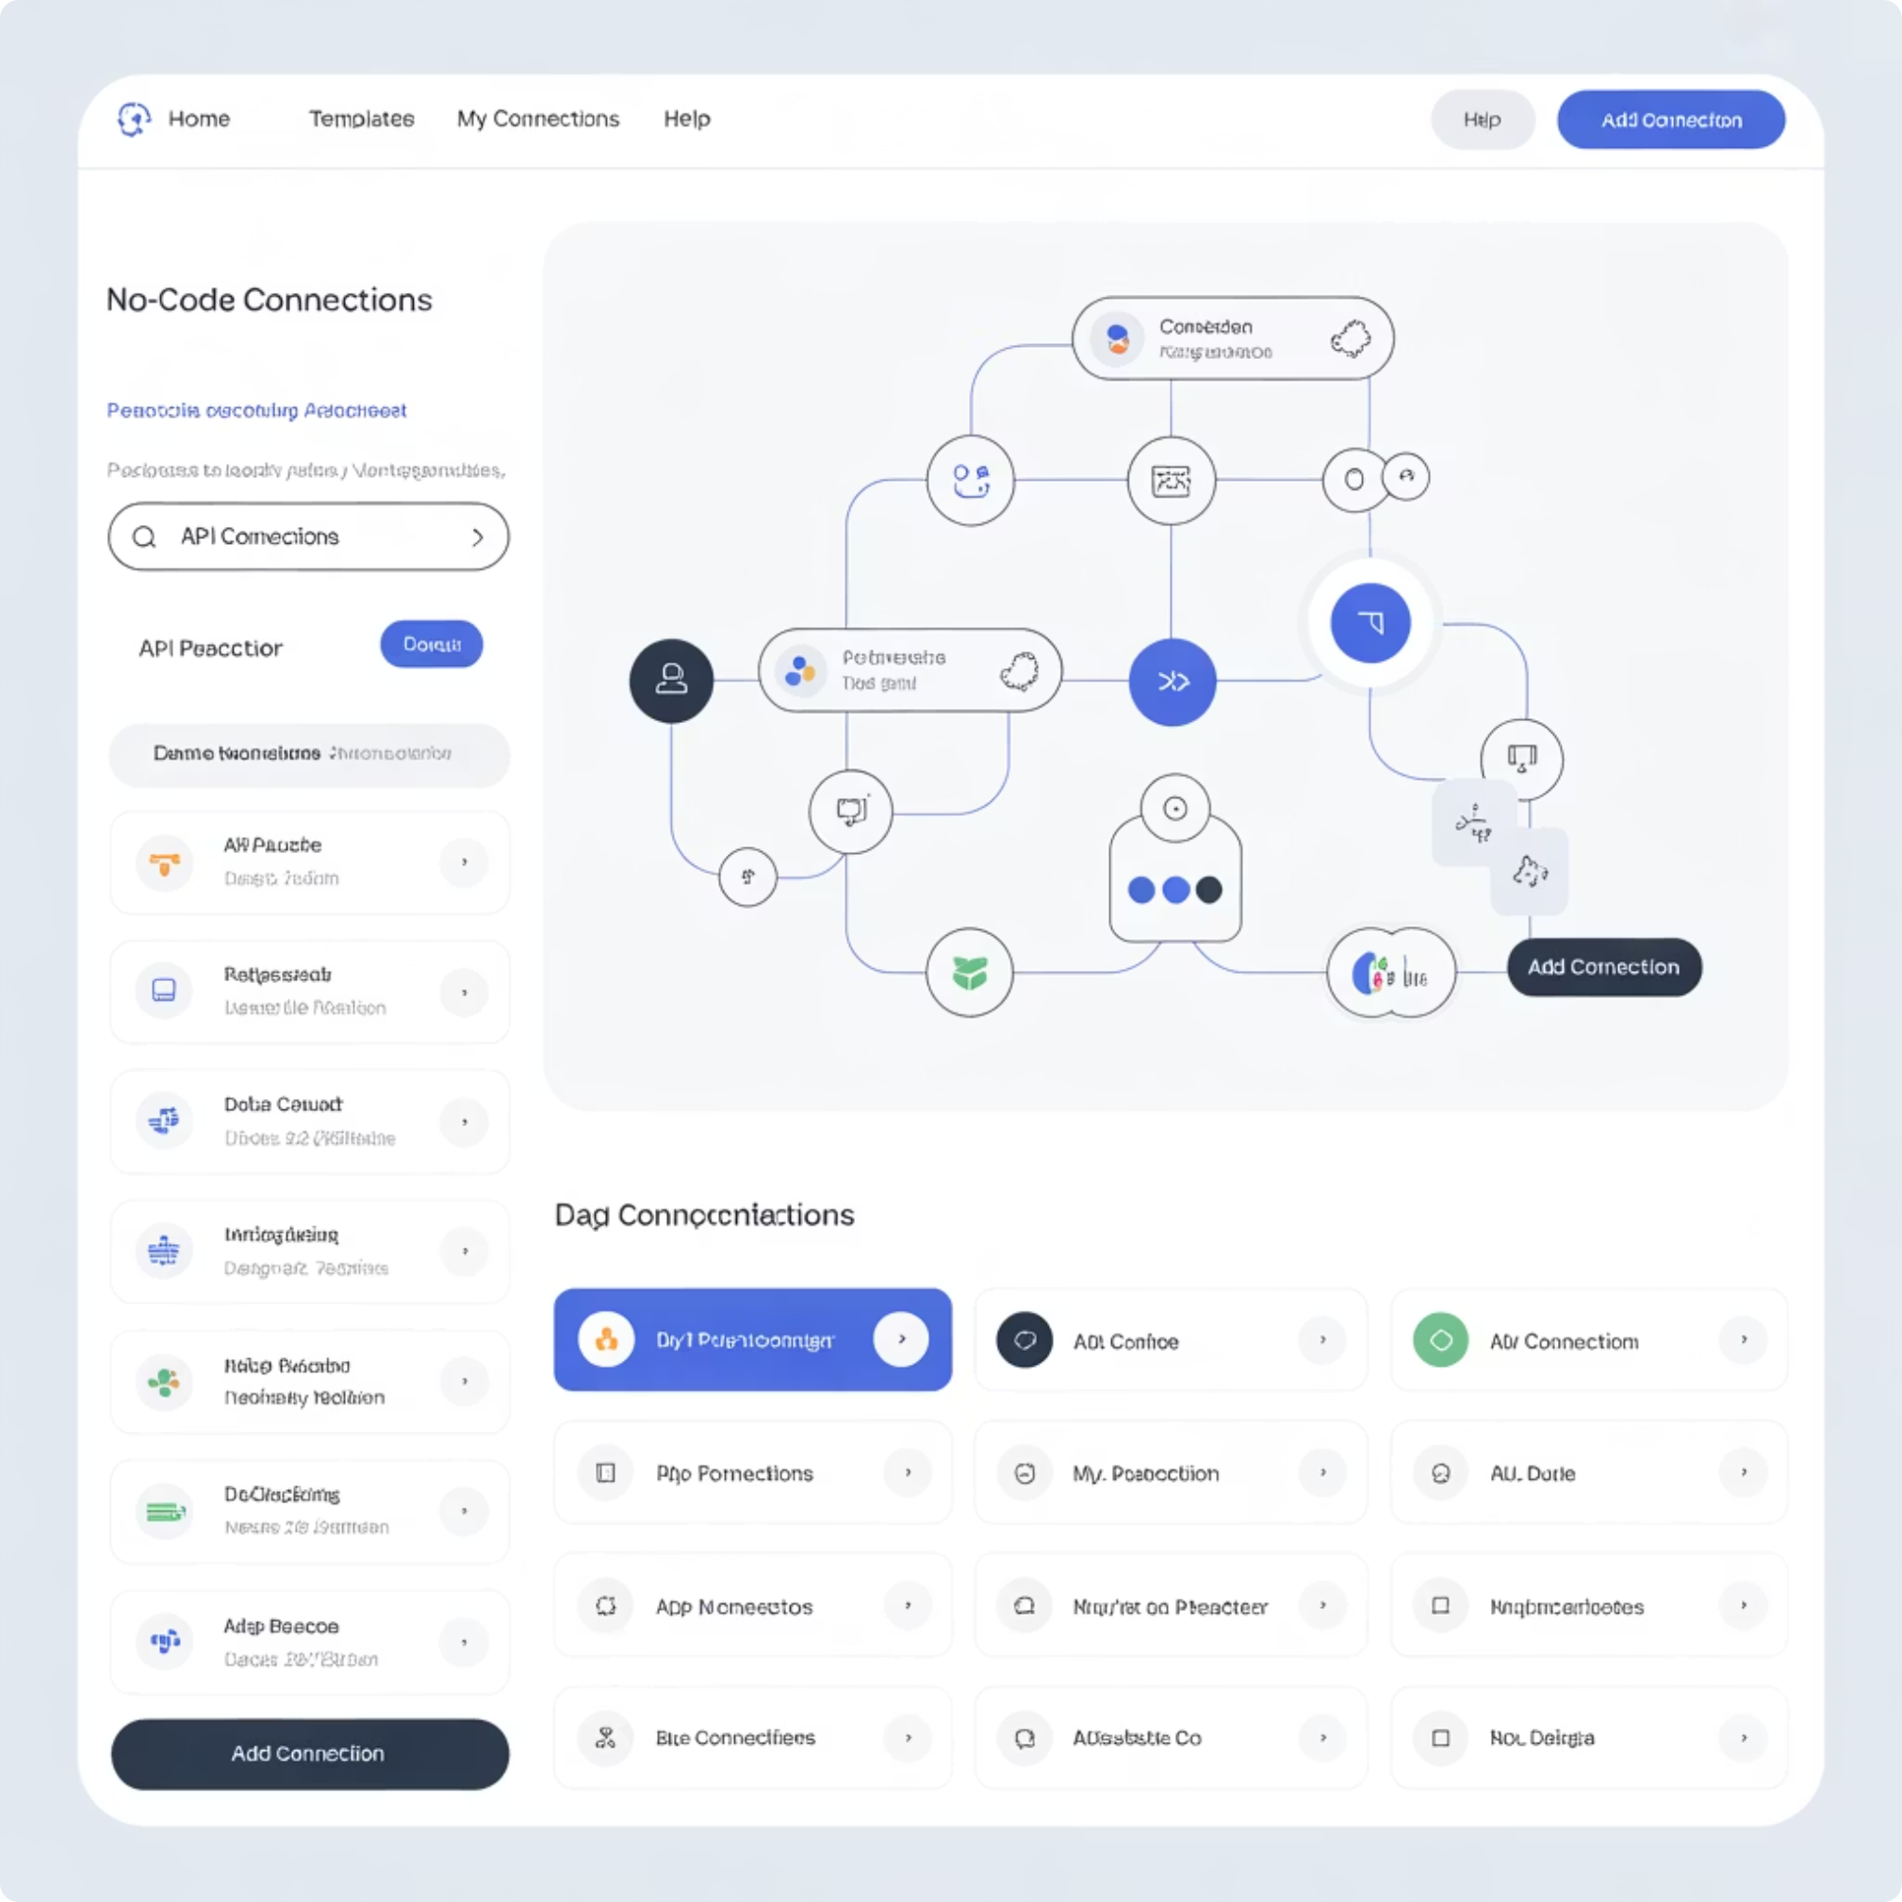
API Integration in Vibe-Coding Tools
How Base44 and Lovable simplify APIs:
User friendly and intuitive interface for API configuration
Copy and paste API URL and authentication keys
Map API responses to your UI elements
Common API use cases:
Generate content with AI (with Open AI, Google, Claude APIs)
Display external data (weather, news, stocks) (with Google's products)
Connect to third-party systems (CRM, email) (i.e. to connect whatsapp)
Process payments securely (i.e. connect Stripe, Paypal services)

Slide 24
Limitations of API Integrations
1
Technical Complexity
Implementation requires expertise in APIs and the specific services being integrated.
2
Dependency on Third-Party Providers
The API provider may experiences downtime, changes in pricing, and other potential challenges.
3
Privacy and Security Concerns
Data sent to external APIs may be stored and processed by the provider, which raises compliance concerns.
4
Recurring Costs
Unlike a one-time software purchase, AI API (i.e. ChatGPT from Open AI) requires ongoing payments per usage (e.g., per word, per request).

Slide 25
API Integrations - Best Practices
Just because an API works in testing doesn’t mean it works reliably and securely..!
Reliability
Security
Availability issues
Always verify the response and test different scenarios
Never expose API keys on the frontend
If the external service is down, your app might break
Add validation or fallback messages in your app
Limit user access to sensitive flows (e.g., payment, database writes)
Monitor the API status (many services provide status pages)
For mission-critical APIs: test, monitor, and build graceful error handling
Use built-in permission settings where possible
Think like a builder: not just “does it look good” but “is it working under the hood?”

Slide 26
Summary
Prototyping is NOT deployment!
Vibe Coding platforms let you build complete applications visually with AI assistance, without needing to write code.
In vibe coding you understand you app by inserting an input and looking on the output ("the black box")
Behind your app:
1
2
3
4
Frontend
Backend
Database
APIs
UI/UX
Logic & Processing
Data Storage & Retrieval
External Services & Integrations
Next up: We'll start building real deployed applications using Base44 and Lovable, putting these concepts into practice!

Slide 27
Questions?

